Slide 1
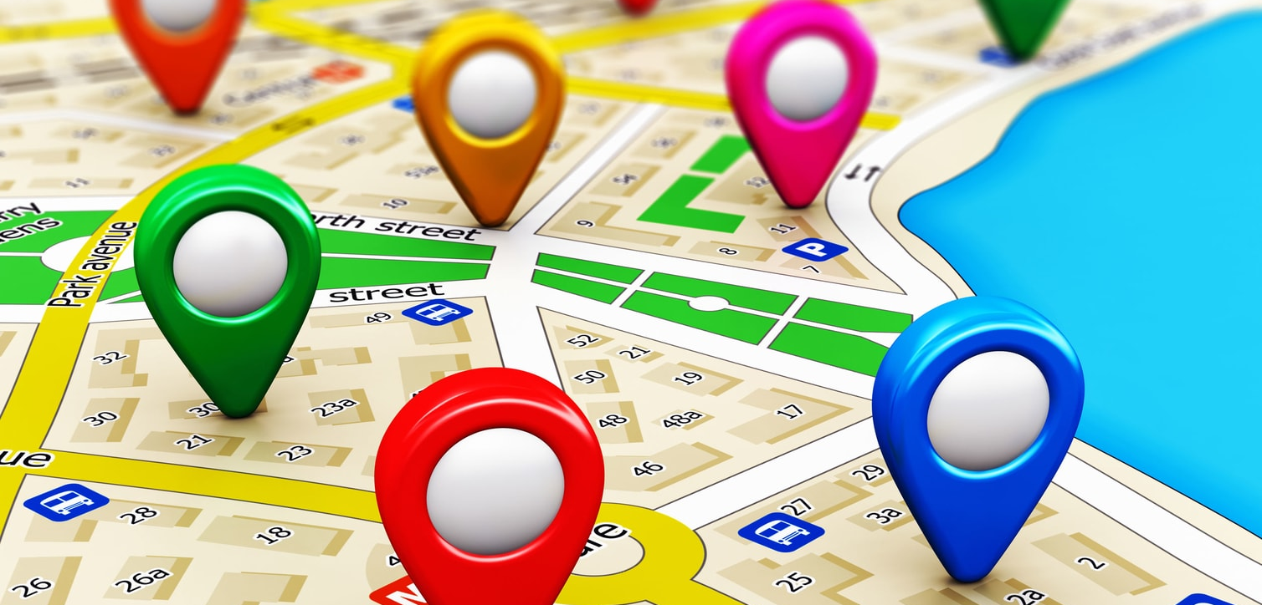

Route Automation with Clustering
Dec 5, 2020
Cristobal Bugeda
Eduardo Garza
Ana Laura Pérez
Cintia Mercado

Slide 2
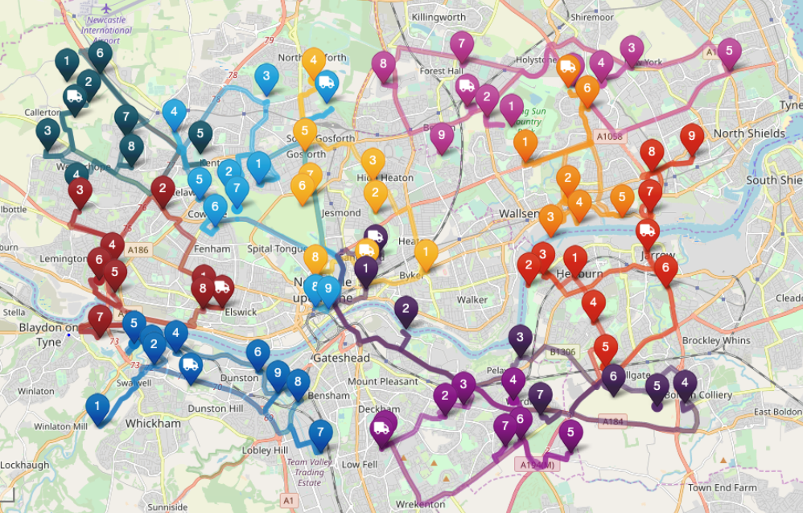
The Problem
A last mile delivery company has several routing tools (optimization, etc.)
Yet, for long routes (40+ destinations), where usually more than 1 vehicle is needed, a plan management tool was developed in which the team manually connects delivery markers to dispatch deliveries in several routes/vehicles:
High cost if iterating all possible routes in google maps to minimize distance
The team relies solely on the human eye to identify clusters, connect markers and then optimize each route
It is a time-consuming practice with not necessarily the best routing solution
Unpractical, cost and time consuming to quote and implement high-volume projects (e.g. 2000 deliveries)
1

Slide 3
Our Proposal
Use Machine Learning to automatically identify clusters to generate required routes based on total deliveries, available vehicles and cargo capacity per vehicle thus speeding-up the process and reducing dependency costs (e.g. Google Maps)
Clustering is an unsupervised machine learning technique
2

Slide 4
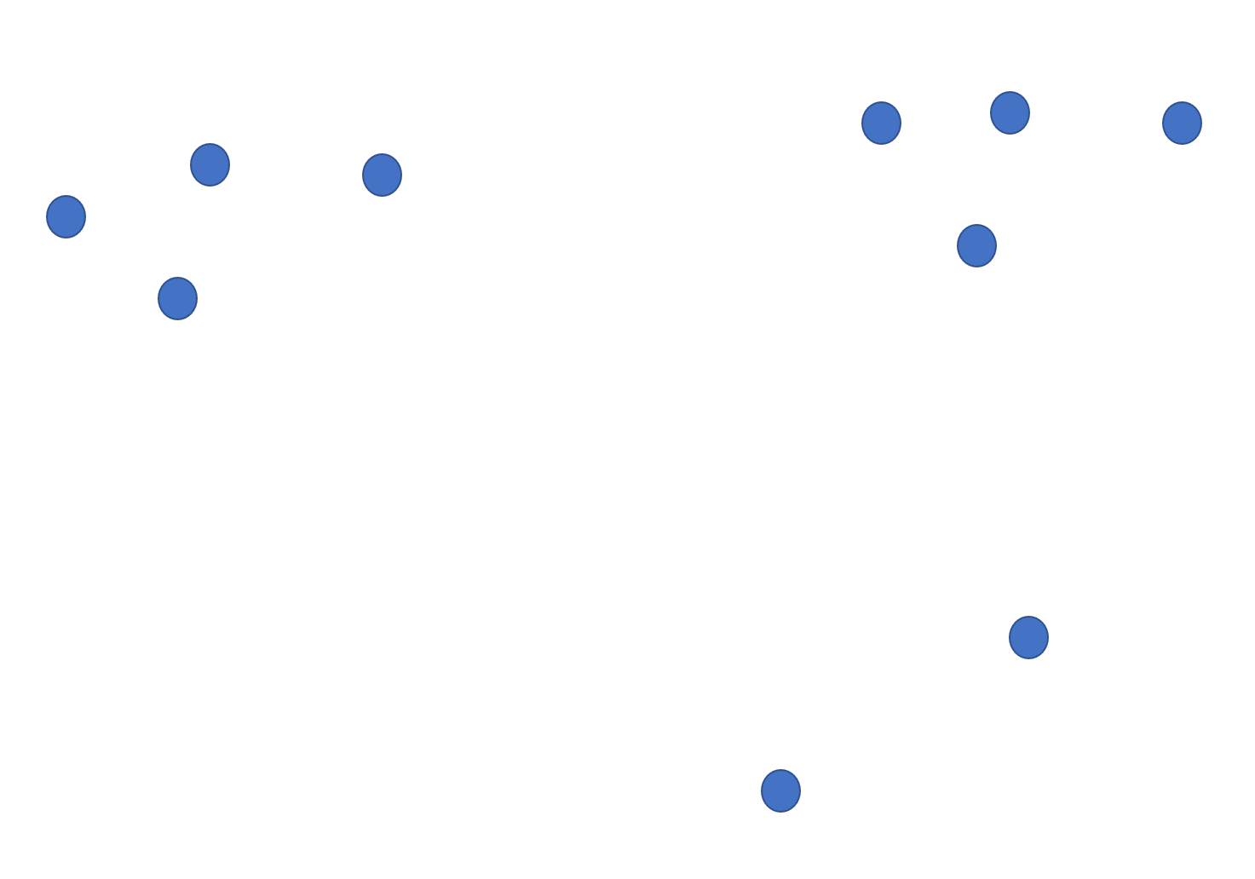
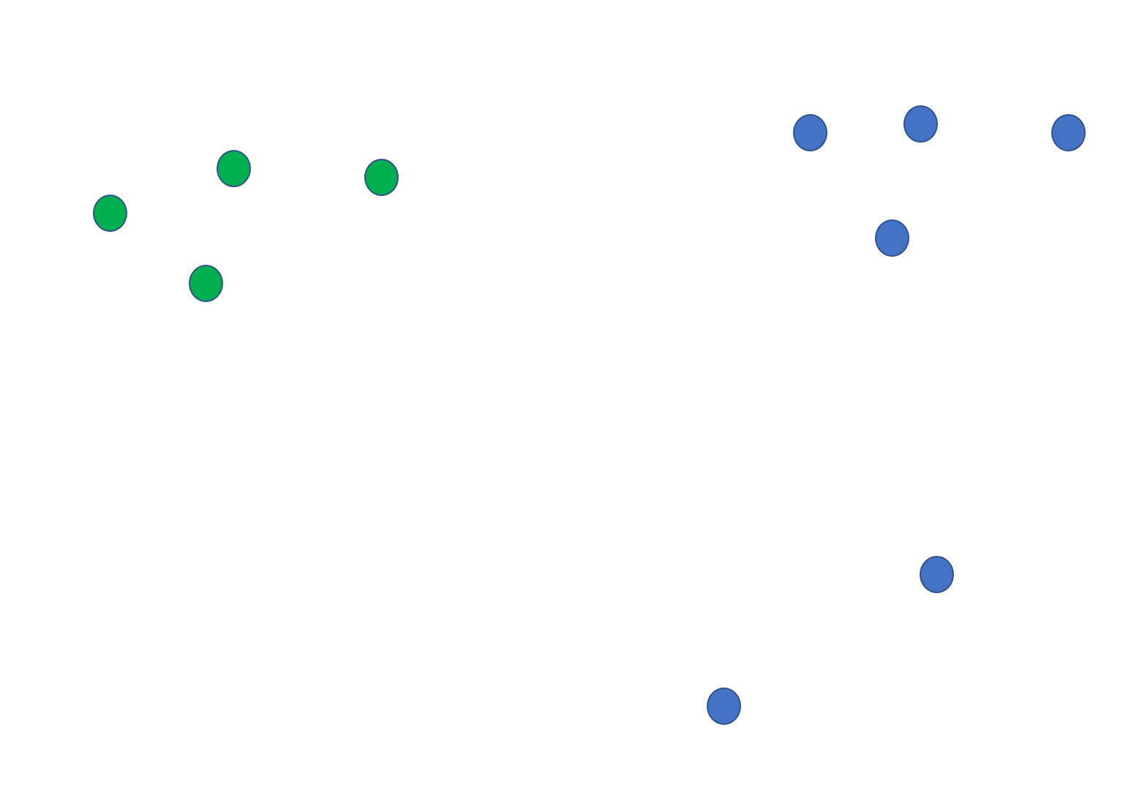
Mockups
1. Add addresses
2. Determine best-fit k based on number of destinations
(# clusters)
3. Show cluster (cluster = route)
(e.g. k = 2)
What is the optimal k?
3

Slide 5

Data Set
1,724 random addresses from previous deliveries were provided by the company in an excel file:
ID
Address
Lat
Lon
ETL:
Clean addresses outside Monterrey metropolitan area
Import data to PostgreSQL database
The demo randomly selects addresses from the DB based on the number of destinations
4

Slide 6








Architecture
app.py
Flask==1.1.1 python-dotenv==0.14.0 SQLAlchemy==1.3.20 psycopg2==2.8.5 gunicorn==20.0.4 numpy==1.18.5 pandas==1.0.5 scikit-learn==0.23.1
FRONT END
Procfile
HTML
JavaScript
Requirement.txt
home.html
cluster.html
clustering.js
Templates
home.html
“MIDDLEWARE”
cluster.html
JSON
Static
BACK END
css
PostgreSQL
app.py
style.css
js
clustering.js
config.js
api/<size>/<seed>/<cargo>/<vehicles>
PostgreSQL
size = # destinations
seed = random state
cargo = Maximum # of packages per vehicle
vehicles = # of available vehicles
5

Slide 7
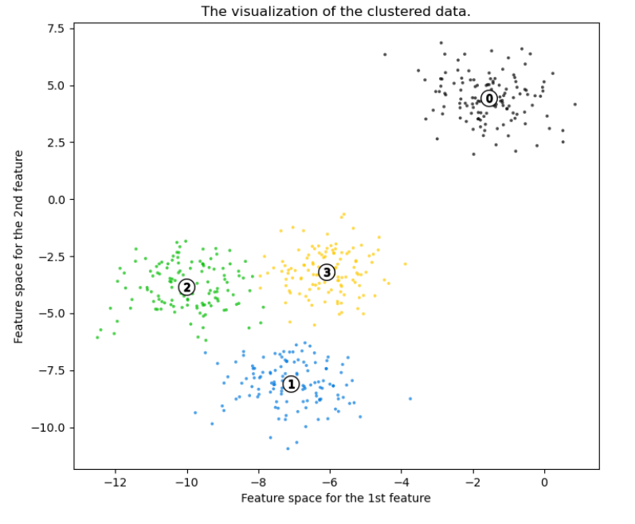
K-Means Silhouette Analysis
“K-means clustering is a simple unsupervised learning algorithm that is used to solve clustering problems.”
“The clusters are then positioned as points and all observations or data points are associated with the nearest cluster, computed, adjusted and then the process starts over again, using the new adjustments until a desired result is reached.”
“Silhouette analysis can be used to study the separation distance between the resulting clusters. The silhouette plot displays a measure of how close each point in one cluster is to points in the neighboring clusters and thus provides a way to assess parameters like number of clusters visually.”
The score is equal to the silhouette score average for the total number of identified clusters, thus a maximum silhouette score is considered the best-fit option
Source:
What is K-Means Clustering? - Definition from Techopedia
Selecting the number of clusters with silhouette analysis on KMeans clustering — scikit-learn 0.23.2 documentation (scikit-learn.org)
6

Slide 8
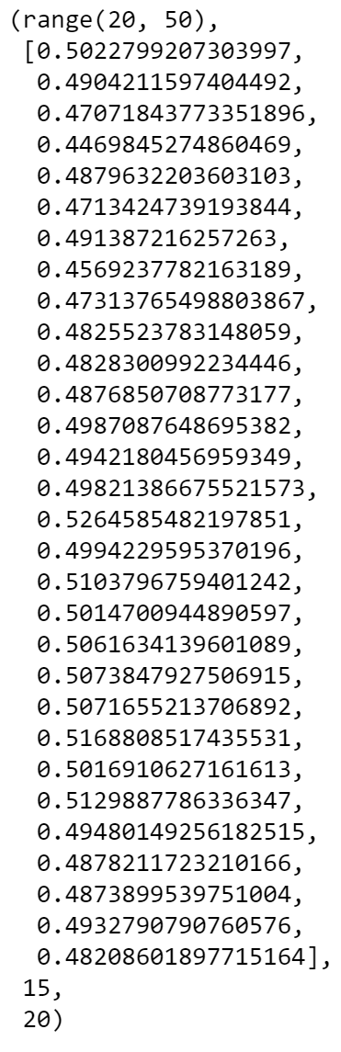
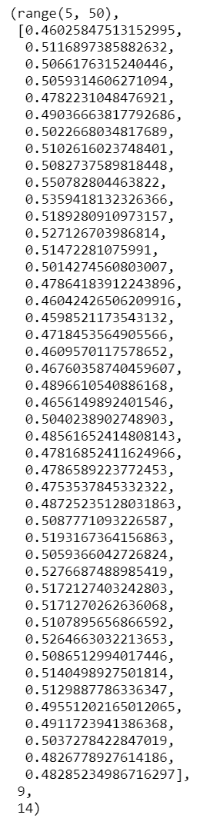
K-Means -> 1. Identify best-fit K with Silhouette Analysis
Re-shape as an array
minK = Maximum between (# destinations/cargomax) and 2
maxK = Minimum between 50 and # of destinations
K-range = range(minK, maxK)
Silhouette scores using K-Means for K-range
Best-fit K = Maximum Silhouette score
Clusters = Minimum between (Best-fit(k) + minK) and # Vehicles
destinations = 100
cargomax = 5
vehicles = 20
destinations = 100
cargomax = 20
vehicles = 100
7

Slide 9
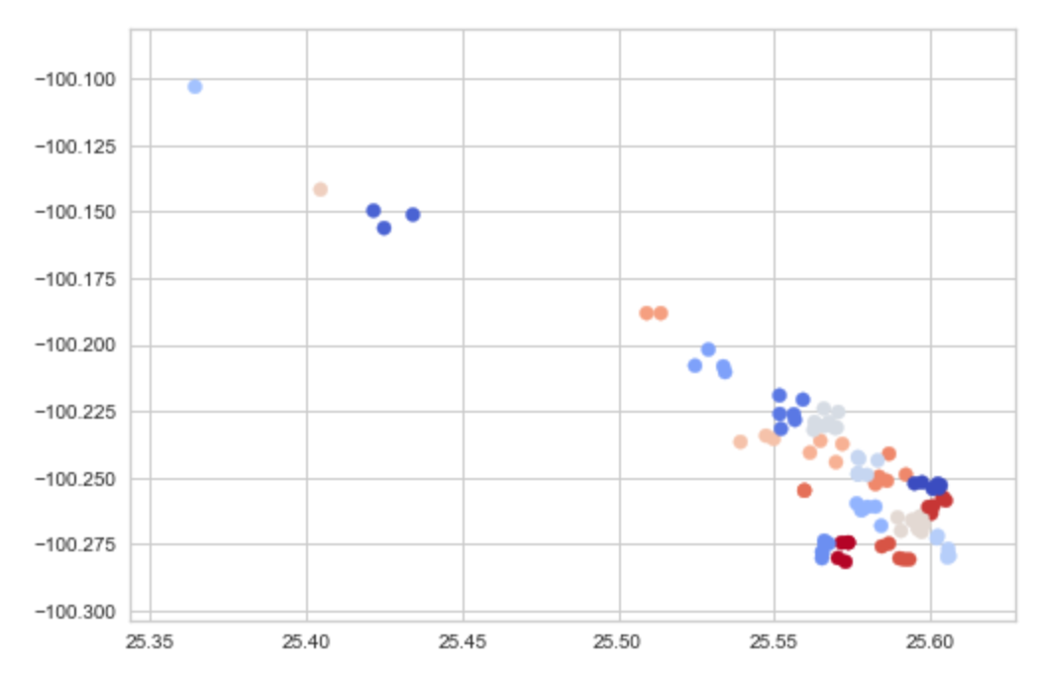
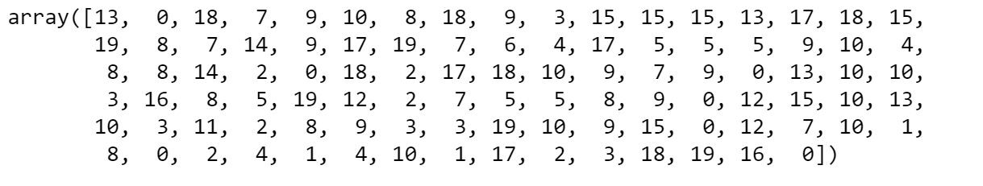
K-Means -> 2. Cluster using best-fit K
Clustering
kmeans = KMeans(n_clusters=index)
kmeans.fit(X)
predicted_clusters = kmeans.predict(X)
Example for 100 destinations in 20 routes (K = 20)
8

Slide 10
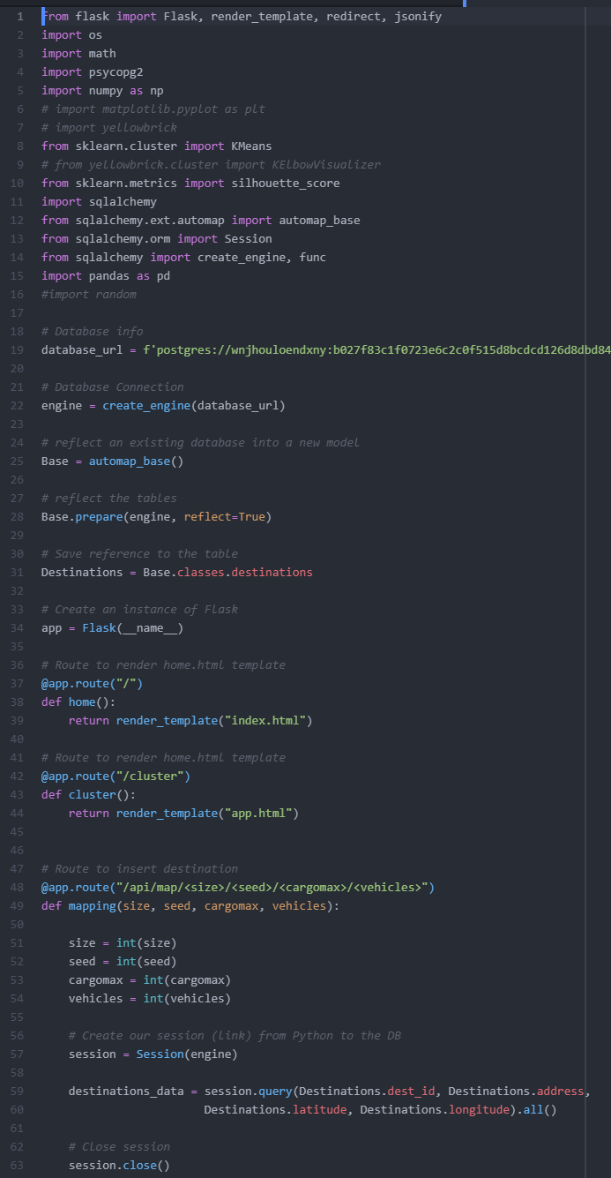
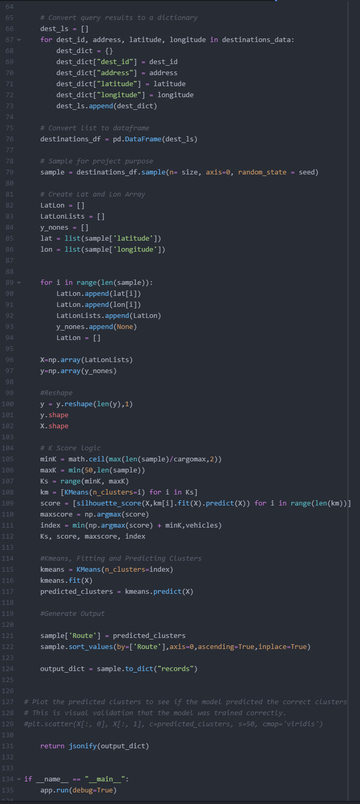
Coding > app.py
Requirements (libraries)
Connect to DB
Render template:
@app.route(“/”)
@app.route(“/cluster”)
Extract destinations
KMeans logic
@app.route(“/api/map/<size>/<seed>/<cargomax>/<vehicles>“)
Jsonify results
9

Slide 11
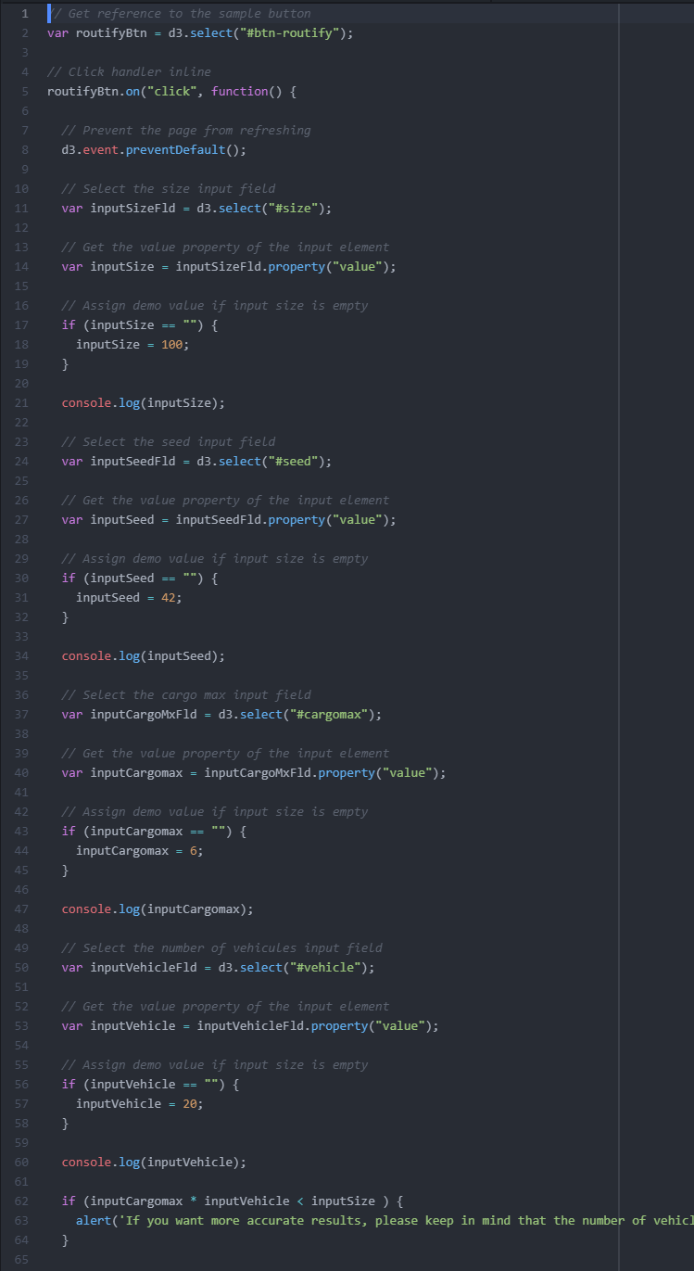
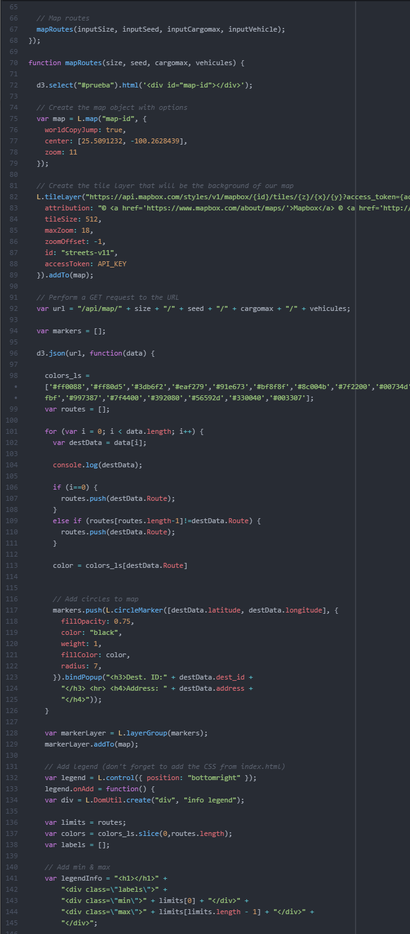
Coding > html / css / .js
Bootswatch (template)
MapBox / Leaflet
Colors for Markers
Color results per route
Map Legends
Alerts
10

Slide 12
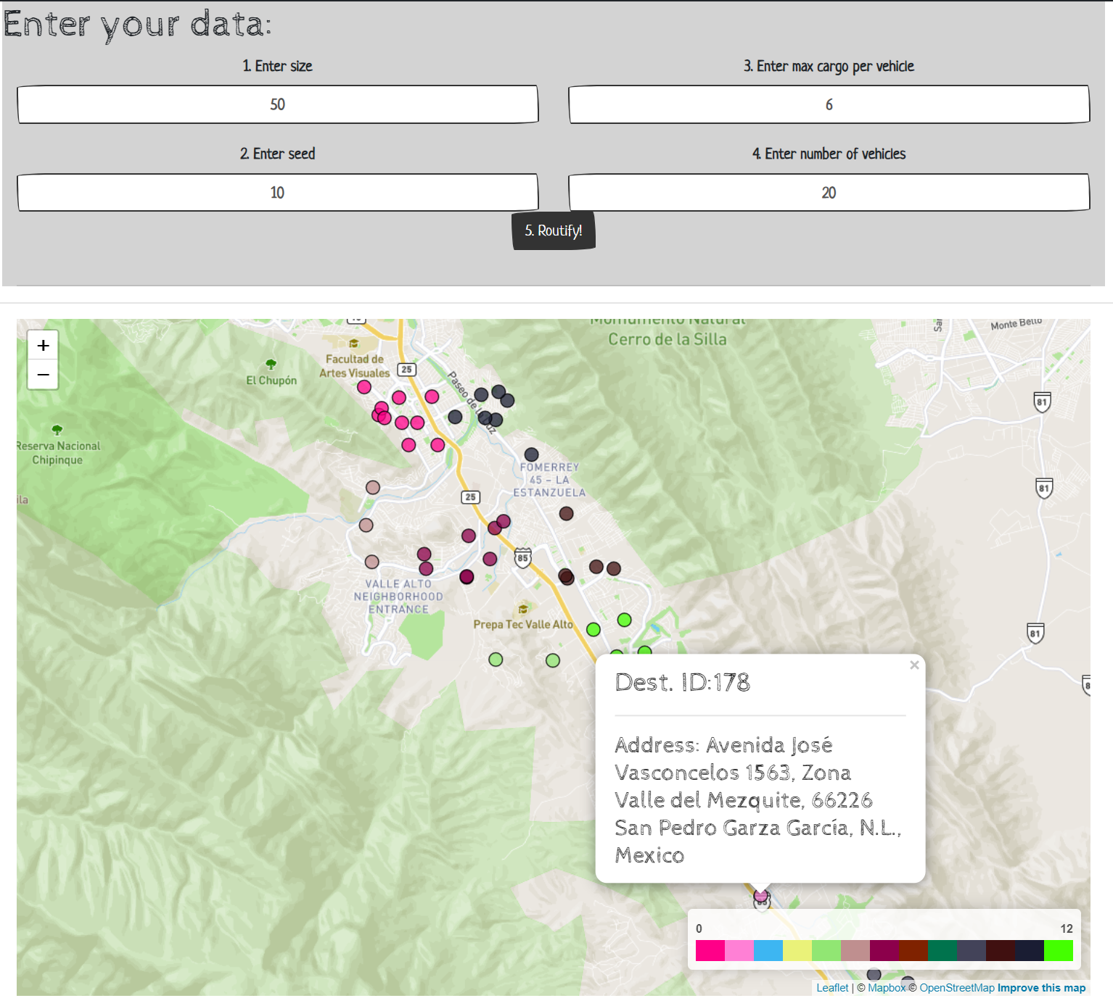
Our Demo
11
https://logistic-clustering.herokuapp.com/cluster

Slide 13
Conclusions
The demo has proven to be a solution that would reduce time and cost for long route projects and quotes
The solution works best applying many destinations in a contained geography (e.g. city)
Avoid outliers, else K would must likely equal 2 (e.g. 1 destination in Querétaro and the rest in Monterrey)
From demo to final product:
Each cluster (route) needs to be optimized using google maps or mapbox apis
UI/UX to import addresses by dispatch team
Test real-life results based on the company’s cost and price equations
Caliber scenarios (set limits) on when cluster automation makes business sense (e.g. # destinations)
Caliber k range (limited to 50)
Include other variables for optimization as for example time restriction
12

Slide 14
Route Automation with Clustering
Dec 5, 2020
Thank you!

